Slide 1
Image credits and copyright compliance
This document and the associated programs/webpages address basic concepts in 3D visualization for end-users (cell biologists). They contain materials (images/codes) made with free open-source programs (or libraries), such as ImageJ/Fiji, UCSF Chimera (along with POV-Ray and other related databases and software), X3DOM, Three.js, and also their online examples.
For some images, public structural biology databases such as PDB, EDS, EMDB, and VIPERdb have been fetched automatically with UCSF Chimera. More detailed information regarding each entry can be found on the websites of these databases. Some other images have been prepared with Matlab and MS PowerPoint, or are personally-taken pictures.
Cell Biological data used here correspond to samples (yeast or mammalian cell) prepared and imaged by the Imaging Facility staff at the Center for Molecular Biology at University of Heidelberg (ZMBH), Germany. Special programs have also been developed for processing such data.

Slide 2
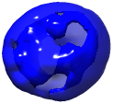
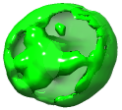

3D visualization for cell biologists
“A picture is worth a thousand words,” and a 3D one …
Aliakbar Jafarpour
Imaging Facility, Center for Molecular Biology at University of Heidelberg (ZMBH), Germany
HBIGS Core Course Fall 2015
jafarpour.a.j@ieee.org

Slide 3
Why 3D (cell Biology)?
“The world is 3D.”
“The future will be all 3D.”
“3D is fascinating.”
“The movie CZ12 was pretty cool.”
“There are even 3D-printed sweets.”
.
.
.
But how relevant is it really for cell biology?
Observing (before thinking) out of the box
“Time to (stop just collecting anecdotes and) dive deeper”
More conclusive and accurate results; out of existing data; with simple tools

Slide 4
Goals of the course
Acquiring hands-on experience with some visualization programs
Learning highly multi-disciplinary concepts in a simple/unified framework
Acquiring self-confidence and team-spirit in evaluation of 3D images
Not being distracted with mathematical or programming details
Having well-documented and easy-to-use references and programs
Having the opportunity of further learning (10 Appendices)

Slide 5
Outline
Quick Reminder
Questions, PC vs. Mac, Fiji
Starting with 3D visualization
3D Imaging, volume and surface visualization, ImageJ and Web browser
3D visualization in Biology
Quantitative 3D imaging, 3D data in structural biology, UCSF Chimera
Different surfaces and navigation schemes
Common surface types and UCSF Chimera galleries
Concluding remarks (dialogue)
Appendices
Web3D exercises, Textures, Hardware acceleration, Rendering, Interactive 3D in PDF and PowerPoint, Tracking in the 3D XYT coordinate, Morphing and component analysis, Isosurface extraction algorithms, 3D ROI, Configuring a computer

Slide 6
Outline
Quick Reminder
Questions, PC vs. Mac, Fiji
Starting with 3D visualization
3D Imaging, volume and surface visualization, ImageJ and Web browser
3D visualization in Biology
Quantitative 3D imaging, 3D data in structural biology, UCSF Chimera
Different surfaces and navigation schemes
Common surface types and UCSF Chimera galleries
Concluding remarks (dialogue)
Appendices
Web3D exercises, Textures, Hardware acceleration, Rendering, Interactive 3D in PDF and PowerPoint, Tracking in the 3D XYT coordinate, Morphing and component analysis, Isosurface extraction algorithms, 3D ROI, Configuring a computer

Slide 7
Quick reminder
To avoid distraction, please use hyperlinks only if necessary.
There is no wrong question. Please ask questions; one doesn’t lose face.
PC (Windows) vs. Macintosh (Apple) computer
Exercise 1: Open, save, re-open, edit, and re-load a webpage.
Quick tour of Fiji (similar to ImageJ)
Exercise 2: Changing image properties such as type, scale …
Exercise 3: Basic 2D processing (with Macro and manual)
Exercise 4: 1D and 3D visualization of a 2D image
Exercise 5: Processing pixels based on value or position
Gradient along y: v = y; Chopping off the left side: v = v * (x > w/2) ; A “Threshold” of 40: v = v * (v > 40); Modulations along x: v = v * abs(cos(2*PI*7*x/w)); “Contour” at a value of 60: v = v * (abs(v – 60) < 3);
 | Copy | Paste | Cut | Find | System Search | Command Shell | Editor | File Browser
PC | Ctrl+C | Ctrl+V | Ctrl+X | Ctrl+F | Ctrl+Escape | Cmd | Notepad | Explorer
Mac | Cmd+C | Cmd+V | Cmd+X | Cmd+F | Cmd+Space | Terminal | Textedit | Finder

Slide 8
Outline
Quick Reminder
Questions, PC vs. Mac, Fiji
Starting with 3D visualization
3D Imaging, volume and surface visualization, ImageJ and Web browser
3D visualization in Biology
Quantitative 3D imaging, 3D data in structural biology, UCSF Chimera
Different surfaces and navigation schemes
Common surface types and UCSF Chimera galleries
Concluding remarks (dialogue)
Appendices
Web3D exercises, Textures, Hardware acceleration, Rendering, Interactive 3D in PDF and PowerPoint, Tracking in the 3D XYT coordinate, Morphing and component analysis, Isosurface extraction algorithms, 3D ROI, Configuring a computer

Slide 9



From raw (2D or 3D) data to 2D screen
Raw (2D) data
2D Screen
1
2
4
4
5
4
4
4
4
5
6
6
3
4
6
7
9
9
4
6
7
9
9
7
6
7
7
7
8
7
6
6
7
7
6
7
Raw (3D) data
Rendered data
2D Screen
1
2
4
4
5
4
Rendering
4
4
4
5
6
6
3
4
6
7
9
9
4
6
7
9
9
7
Mapping between 2D screen (pixels) and the 3D scene (objects, illumination, …)
6
7
7
7
8
7
6
6
7
7
6
7

Slide 10

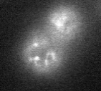
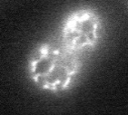
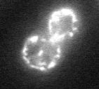
Can a 3D printer print a (rescaled) z-stack?
What are different aspects/parameters of 3D visualization?
?
?
“3D-printable”
3D Visualization
?
?
?
y
x
z
Terminology
Z-stack: A series of images acquired (using a confocal microscope by focusing) at different depths or “z values”.
Z-stack of Yeast cell. Sample preparation and imaging by Christian Hörth using a Leica TCS SP5 confocal microscope.

Slide 11
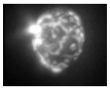
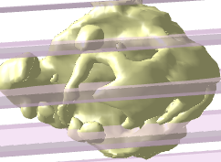
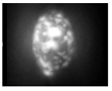
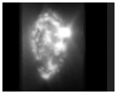


3D Imaging: Two techniques
Z-stack (confocal microscopy) vs. tomographic imaging (CT scan …)
Implication for 3D visualization?
Z Stack
$"φ$ Stack” (tomograms)
y
2D Projection
=
$$φ$$
x
z
1D Rotation

Slide 12
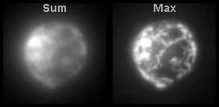
Volume rendering: Technique
Maximum-intensity projection (MIP)
Similar to tomographic imaging
The only cause of uncertainty: (3) rotation parameters + Threshold
Sum projection
More parameters for transparency, smoothing … (+ or -)
3D Perception
3D volume data
3D Object
3D Imaging
1D Rotation
2D (Rendered) Image
Terminology
- Rendering = From 3D data to a single 2D image (screen)
- “Rotating 3D object” = Animation of rendered images

Slide 13
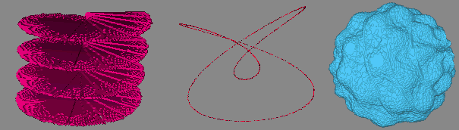
Volume rendering: Exercises
Exercise 6: Volume rendering without 3D Viewer
With Macro and manual
Exercise 7: Generation and visualization of 3D volumes
Helicoid, knot (biological relevance?)
With Macro and manual (continuation of Exercise 5)
Question 1: How can one avoid disconnections in a 3D curve?
Question 2: Are 2 or 3 parameters needed for 3D rotations?

Slide 14
What are different aspects/parameters of 3D visualization?
Volume vs. Surface
(Iso)Surface
Extraction
3D biological imaging
3D medical imaging
3D molecular orbitals
?
3D scanners
3D AFM imaging
?
Volume vs. Surface
3D computer graphics
3D printers
3D Web
3D PDF
3D molecular surfaces
3D games
3D Visualization
?
?
?
Terminology
- Isosurface = A 3D contour; the surface over which the z-stack has the same value (Different isosurfaces for different values).

Slide 15

Surface rendering: Exercises with ImageJ
Exercise 8: Generation and visualization of 3D surfaces with Macro
Exercise 9: Exporting the surface as a 3D-printer-compatible file
Exercise 10: Exporting the surface as a 3D-PDF-compatible file

Slide 16
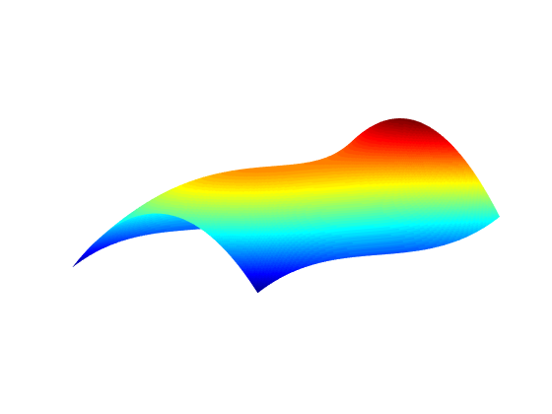
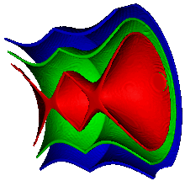
Putting “3D surface” into perspective Contours and variation/visualization dimensions
A Line in a single confocal image
A single confocal image
A confocal z-stack
I = f₁(x)
I = f₂(x,y)
I = f₃(x,y,z)
1D Variations (2D Visualization)
2D Variations (3D Visualization)
3D Variations (in 4D Space)
I
y
Homework for volunteers!
x
“3D surface”
z
y
x
1D Variations (1D Visualization)
0D (point) contours
2D Variations (2D Visualization)
1D (curve) contours
3D Variations (3D Visualization)
2D (surface) contours
Isosurface visualization (of a z-stack)

Slide 17
Connectivity of (iso) surfaces
No problem with disconnected surfaces!
Connected surface (in image) ≠ Physically-connected surface
Connected surface (in image) = Full coverage with visible fluorophores
Reasons for invisibility of fluorophores
Intensity (isosurface) level, optical resolution, quenching of excited fuorophores, formation of no excited state (static quenching)
POV-Ray rendering of yeast cell isosurfaces (with thresholding*) with UCSF Chimera. Sample preparation and imaging by Christian Hörth using a Leica TCS SP5 confocal microscope.

Slide 18





Web 3D visualization of a Surface
Visualization of surfaces (“standard 3D data”)
Visualization programs (ImageJ, Chimera), Web browser, Acrobat Reader ….
Support for 4D data: “free-viewpoint video renderer”
3D volume Data
3D surface Data
Rendered 3D Data
y
x
z
“Simple” programming
Not so simple programming!
Warning: Web browsers can have security issues, some of which originate from Javascript programs (as used in Web 3D). One practical way of enhancing security is using programs like NoScript and allowing only “trustable” websites. Surfing Internet and randomly watching 3D content from unknown origins is discouraged.

Slide 19
Who deals with how much programming? (Browser-based Visualization)
Programming
“No”
Yes (“Simple”)
Yes (Rigorous)
Yes (Rigorous)
We
Program
API (X3DOM, Threejs …)
Browser (OpenGL)
We do (nontrivial) interpretation!
30 lines of (Javascript/HTML/CSS) code
27,000 lines of (Javascript/HTML/CSS) code
“Computer system”

Slide 20
Surface rendering: Web 3D Exercises
Exercise 11: Visualizing the binary STL file with Firefox (HTML code)
Rescaling the z-stack may be needed (dimensions ~ 1 unit)
Exercise 12: Visualizing the Wavefront (obj/mtl) file with Firefox (HTML code)
Rescaling the z-stack may be needed (dimensions ~ 1 unit)
Offline Web3D
Downloading necessary files of Wb3D on local machines
No need for internet connection (one-time-only download)

Slide 21

Volume vs. Surface rendering
In brief: Complementary methods
Parameter-dependence (uncertainty) in both cases
Several improvement options
Monitoring the internal content (Image and Animation galleries of UCSF Chimera)
Web 3D programs (Three.js, X3DOM …) for improved visibility of structure

Slide 22
Outline
Quick Reminder
Questions, PC vs. Mac, Fiji
Starting with 3D visualization
3D Imaging, volume and surface visualization, ImageJ and Web browser
3D visualization in Biology
Quantitative 3D imaging, 3D data in structural biology, UCSF Chimera
Different surfaces and navigation schemes
Common surface types and UCSF Chimera galleries
Concluding remarks (dialogue)
Appendices
Web3D exercises, Textures, Hardware acceleration, Rendering, Interactive 3D in PDF and PowerPoint, Tracking in the 3D XYT coordinate, Morphing and component analysis, Isosurface extraction algorithms, 3D ROI, Configuring a computer

Slide 23
3D visualization, biology, … and others
Goal
(Quantitative) 3D imaging in cell biology
New
Fast 3D visualization and analysis with common hardware and software
Not new
Quantitative 3D imaging in (structural) biology
Starting point
(Nuts and bolts of) 3D visualization
3D Imaging (and manufacturing)
3D Analysis
3D Visualization
(More accurate and conclusive) biology
Art
Entertainment
Marketing

Slide 24

The knobs of 3D visualization
Rendering (many knobs)
Quantitative
1
2
4
4
5
4
Rendering
4
4
4
5
6
6
3
4
6
7
9
9
4
6
7
9
9
7
6
7
7
7
8
7
6
6
7
7
6
7
Apparent shape (zoom, orientation …)
Actual shape (geometry, isosurface …)
Volume vs. Surface
3D Visualization
Actual intensity (threshold, transparency …)
3D (surface) file formats
Artificial color (object, background, illumination …)

Slide 25
Subjective aspects of 3D visualization
Subjective factors affecting 3D vision
Subjective
Raw 3D data
Rendered (2D) data
Human vision, perception, cognition
?
?
?
Prior knowledge
3D Visualization
?
?
?
And the other way around: 3D vision affecting subjective factors
The real-life dangers of augmented reality
How does 3D visualization help with quantitative imaging, … if at all?

Slide 26
The conclusion after 3D visualization
Cell Biology?
Accurate objective conclusion (mechanical design, …)
Accurate objective conclusion (mechanical design, structural biology …)
Accurate “subjective” conclusion (surgery with augmented reality …)
3d visualization
Qualitative conclusion (elucidating mechanisms …)
Dramatized conclusion (entertainment …)
3D visualization: Semi-quantitative and partially-subjective perception of 3D data
Trade-off between “quantitative information” and “nice 3D look”
Orthogonal vs. perspective projection, 3D manufacturing vs. 3D game …
3D quantification and 3D visualization: Completing and cross-validating each other
1
2
4
4
5
4
3D Quantification
4
4
4
5
6
6
3
4
6
7
9
9
Quantitative 3D imaging
Quantitative 2D imaging
4
6
7
9
9
7
3D Visualization
6
7
7
7
8
7
6
6
7
7
6
7

Slide 27

3D data in Structural Biology
Electrons
X-ray
3D Object
“Fourier Transform”
2D Projection
2D Scattering Pattern
Key-words and references
PDB ID
Electrostatic potential
Resolution distance
Viruses with icosahedral symmetry
International Tables for Crystallography
3D Imaging Modality | Database | Visualization Program | Reconstruction Program | Measured Quantity
X-ray Crystallography | EDS (PDB) | Chimera, … | CCP4 , XDS , … | Electron density
Single-Particle Electron Microscopy (EM) | EMDB | Chimera , … | SPIDER, EMAN , … | Electrostatic potential
Takehome messages
Data: Available, free, and reliable
Visualization tool: UCSF Chimera …
Visualization results + biological interpretation: Detailed and well-documented (in associated journal papers)

Slide 28
The visualization program UCSF Chimera
Data
Variety of input file formats
Variety of output file formats
Support for physical 3D input (“3D mouse” …)
Processing and analysis
3D image processing (smoothing, segmentation, Fourier Transform, …)
Visualization and analysis of molecular structures
(Python) Scripting for batch-processing and automation
Visualization
“Fast” or “high-quality” 3D visualization
4D (3D + Time) support

Slide 29
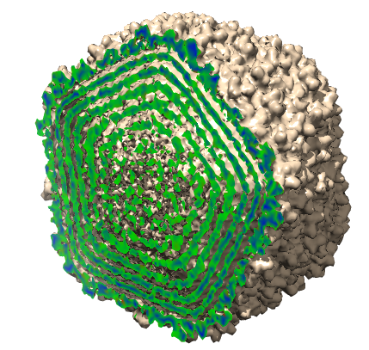
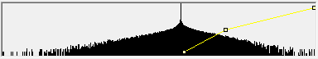
Fetching density maps (volume data) from databases
Exercise 13: Fetching volume data using EMDB ID (5206)
Exercise 14: Fetching volume data using EDS ID (4TX2)
Volume rendering: Raw data (x axis) vs. dynamic range of visualization (y axis)
Noise histogram
Baseline
Data
P2(x,y)
P3(x,y)
P1(x,y)
Step 1: Background subtraction
Smallest x with no background , where P1(x,Min) and P2(x + [1 step], Max)
Steps 2 and 3 (iterations): Efficient use of dynamic range
Step 2: “Best” y for efficient dynamic range, where P2(current x, y)
Step 3: “Best” x for efficient dynamic range, where P2(x, current y)
POV-Ray surface rendering of Epsilon 15. Data imported from EMDB (ID: 5206) and visualized (binned, sliced, cap-colored with density values) using UCSF Chimera.
Terminology
Different keywords for volume data values:
Cell Biology | Structural Biology | Computer Graphics | Others
Intensity | Density Map | Texture Atlas, 3D Texture | Function, Value, Data …

Slide 30
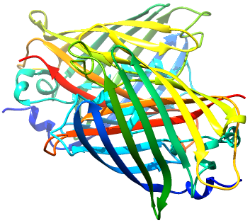
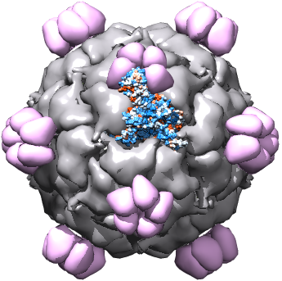
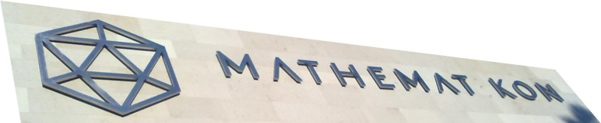
Fetching surface data from databases
Exercise 15: Fetching surface/chemical structure with PDB ID (1GFL and 2H5Q)
Exercise 16: Fetching surface/chemical structure with VIPERdb ID (2BPA)
POV-Ray rendering of Green Fluorescence Protein (GFP). Data imported from PDB (ID: 1GFL) and visualized using UCSF Chimera.
POV-Ray rendering of Bacteriophage Φ-X 174. Data imported from VIPERdb (ID: 2BPA) and visualized using UCSF Chimera.
Question 3: Bacteriophage Φ-X 174 (VIPERdb 2BPA) and the Epsilon 15 virus (EMDB 5206) have a capsid in the shape of a (distorted) icosahedron. What (mathematical, chemical, and biological) significance can be mentioned for this shape?

Slide 31
From structural to cell biology
Resolution span: > 3 orders of magnitude (1000 times)
Ultimate resolution with crystallography: ~ 0.15nm
Different meanings of resolution (with different methods)
Imaging Technique | Resolution distance | Atomic resolution
X-ray crystallography | ~ 0.15nm (< 0.45nm) | Yes (Fitting used)
Single-particle electron microscopy | < 1nm | No (Usually)
Superresolution optical imaging | > 30nm | No
Optical imaging | > 200nm | No
Terminology
High-resolution = Low resolution distance (In the quest towards high resolutions, a resolution distance of 200nm is considered better than 300nm. But 200 is not higher than 300!)

Slide 32
Visualization of z-stacks with UCSF Chimera
(8-bit) Z-stack visualization (Exercise 17)
Transparency, threshold …
No local coordinate, as opposed to ImageJ (which requires registration)
Exporting surfaces (Exercise 18)
.X3D format and X3DOM
“Isosurface” and thresholding (Exercise 19)

Slide 33
Question
Question 4
What is Photo51?

Slide 34
Outline
Quick Reminder
Questions, PC vs. Mac, Fiji
Starting with 3D visualization
3D Imaging, volume and surface visualization, ImageJ and Web browser
3D visualization in Biology
Quantitative 3D imaging, 3D data in structural biology, UCSF Chimera
Different surfaces and navigation schemes
Common surface types and UCSF Chimera galleries
Concluding remarks (dialogue)
Appendices
Web3D exercises, Textures, Hardware acceleration, Rendering, Interactive 3D in PDF and PowerPoint, Tracking in the 3D XYT coordinate, Morphing and component analysis, Isosurface extraction algorithms, 3D ROI, Configuring a computer

Slide 35
Surface extraction and rendering
Types of surfaces (extracted from volume data)
Sections (planes, spherical shells, Application-specific)
Segmented volume data
“Isosurfaces” or 3D contours
Volume data gallery of Chimera
Volume data
Isosurfaces
Planar
Spherical
Sections
Segments
Application-specific

Slide 36
3D inspection with UCSF Chimera
Favorite Menu
Command-line
Side View
Common animations
Simple spinning: movie record ; turn y 1 360 ; wait ; movie encode (Exercise 20)
Stopping: Freeze
Frame-depdent operations: perframe (correction for background; Exercise 21)
More examples: 1, 2, and 3
Clipping and slicing (Exercise 22)
Editing volume data with vop
Photo 51 in 3D (Exercise 23)
What other scattering patterns had Gosling and Franklin seen?
Planar sections through 3D Fourier transform of a double-helix
Fiber diffraction: 1, 2, 3

Slide 37
Outline
Quick Reminder
Questions, PC vs. Mac, Fiji
Starting with 3D visualization
3D Imaging, volume and surface visualization, ImageJ and Web browser
3D visualization in Biology
Quantitative 3D imaging, 3D data in structural biology, UCSF Chimera
Different surfaces and navigation schemes
Common surface types and UCSF Chimera galleries
Concluding remarks (dialogue)
Appendices
Web3D exercises, Textures, Hardware acceleration, Rendering, Interactive 3D in PDF and PowerPoint, Tracking in the 3D XYT coordinate, Morphing and component analysis, Isosurface extraction algorithms, 3D ROI, Configuring a computer

Slide 38
What we have learnt
Input data
3D volumes: 8-bit z-stacks, structural biology (EDS and EMDB) databases …
3D surfaces: volume-extracted, molecular surfaces (PDB) …
Volume
Importing, processing, visualizing, and superimposing 8-bit volume data
Surface
Extracting isosurfaces, segments, and sections
Visualizing, coloring, and illuminating surfaces
Multiple objects
Superimposing, morphing
Scripts
Numerous images and animations along with scripts (UCSF Chimera) + Macros (ImageJ)
Output data
Movies
3D surfaces and formats
(High-quality) Rendered images
Interactive documents (PDF, PowerPoint, HTML)

Slide 39
Minimum validation tests
Visibility
Transparency, rotation (animation, mirror), lighting, background color, surface color
Dark (rendered) pixel can mean
Small data value, or
Possibly large data value + {inappropriate lighting and surface/color background}
General tests
Different visualization schemes
Viewing along different directions
Unreliable rendering of voxels far from normal view (nearly-flat surfaces)
Small changes (transparency, threshold, noise, smoothness, …) and associated effects

Slide 40
Possible things to look for in 3D images
Does the object (or parts of it) seem to have a special shape?
(Quasi-)Periodic, helical, tubular, fractal, sparse, …
What image processing schemes enhance/select/quantify such shapes?
How much of (seemingly-) overlapping objects in the projected image actually overlap in 3D? (tubular example)
Different iso-surface values (or segmentation parameters) result in different numbers of segments. What does it mean? What can be done?
How similar or different is the object (confocal microscopy) from the output of 3D deconvolution (widefield microscopy)?
In what way(s) is the object different from “expectations”?
How can it be clearly quantified? What does it mean for different hypotheses?
Process of elimination
What are some potential scenarios (based on prior knowledge and/or new data)?
Which ones can we prove (or rule out)? → Partially-conclusive results
Which ones cannot we prove (or rule out)? → Designing new experiments
What are observations and what do they mean biologically/biochemically?

Slide 41
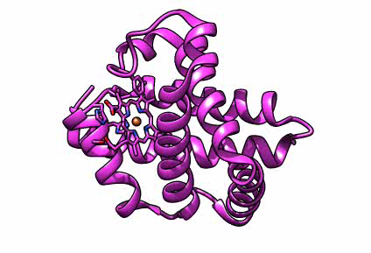
3D visualization results for others
Even a well-visualized 3D structure is not self-explanatory.
Others may not know 3D visualization concepts or techniques.
Observation (and concluding biological meaning) should be explicitly stated.
Example (Ultrafast dynamics in myoglobin):
Observation and conclusion
“Structural changes appear throughout the protein within 500 fs with the C-, F- and H-helices moving away from the heme and the E- and A-helices moving toward it.” (Science DOI: 10.1126/science.aac5492)
“ … an immediate collective response of the protein takes place upon ligand dissociation due to coupling of vibrational modes of the heme to global modes of the protein.” (Science DOI: 10.1126/science.aac5492)
Ultrafast dynamics in myoglobin from 0-0.6 ps.
Visualization and surface morphing using UCSF Chimera with four PDB entries: 5CN5, 5CN7, 5CN9, and 5CNC.
Reference: Science DOI: 10.1126/science.aac5492

Slide 42
Additional exercises
Exercise 24
Drawing a molecule by making (shape sphere) and moving (move) elements using Chimera
Exercise 25
Zoom-in/out (scale 1.02/0.98 100) and fly-through (fly 30 p1 p2 p3 p4 p5) with Chimera
Exercise 26
3D profile of (diffraction-limited) focused light and its dependence on color/lens
Exercise 27
Maximum bulk coordination number in a crystal (12 icosahedron vertices)
Exercise 28
Observation (and correction) of aliasing in ImageJ 3D Viewer
Exercise 29
Isosurface synthesis and extraction
Exercise 30
Miscellaneous movie-related commands in UCSF Chimera

Slide 43
Answers to questions
Question 1
Smoothing; showing each point with a sphere (multiple voxels); denser curve sampling …
Question 2
2 parameters for rotation (of camera) on a sphere (surrounding the object)
3 parameters for arbitrary 3D rotations: 2 for axis of rotation (on a sphere) + 1 for angle
Question 3
An icosahedron is a convex polyhedron with 20 triangular faces and 12 corners (vertices). When projected onto a sphere surrounding it (looking like a Soccer ball), it will create 60-fold 3D rotational symmetry. If similar spherical atoms are to be packed with the highest density, they will do it by sitting on the corners of an icosahedron (centered at the surrounded atom). Many viral capsids have the shape of a (deformed) icosahedron, with some featuring a unique vertex. There are also inorganic Boron-based lattices formed with icosahedra and icosahedral quasicrystals (projections of a 6D crystal in 3D).
Question 4
Photo 51 is the first known measured X-ray scattering pattern of DNA; implying its helical symmetry. It is famous not only because of the biological significance and the 1962 Nobel Prize, but also because of the controversy over fair credits and the role of Rosalind Franklin.

Slide 44
Outline
Quick Reminder
Questions, PC vs. Mac, Fiji
Starting with 3D visualization
3D Imaging, volume and surface visualization, ImageJ and Web browser
3D visualization in Biology
Quantitative 3D imaging, 3D data in structural biology, UCSF Chimera
Different surfaces and navigation schemes
Common surface types and UCSF Chimera galleries
Concluding remarks (dialogue)
Appendices
Web3D exercises, Textures, Hardware acceleration, Rendering, Interactive 3D in PDF and PowerPoint, Tracking in the 3D XYT coordinate, Morphing and component analysis, Isosurface extraction algorithms, 3D ROI, Configuring a computer

Slide 45
Appendix 1: Web3D exercises
Trying and editing sample HTML files
Exercise 31: Text styles (W3 School)
Exercise 32: 2D Gallery (W3 School)
Exercise 33: Basic 3D shapes (X3DOM)
Exercise 34: 3D Gallery (X3DOM)
Synthesis of a surface with known equation
Wolfram
Three.js

Slide 46

Appendix 2: Textures
Is an image just a set of (pixel/voxel) values?
Shapes
Values
Shapes
& Values
Image:
(Full domain + ) Values
(Specific) Shape + Values (over the shape only)
3D Volume data: Values (over the domain)
3D Surface data: Shape + Values (= texture)

Slide 47
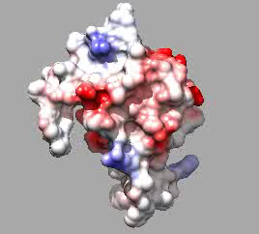
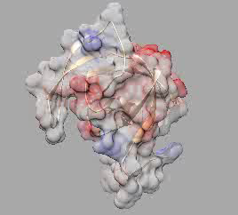
Texture for 3D surfaces
Electrostaic potential as a texture for molecular surface
Question: Does the red color imply (by convention) positive or negative charge?
Exercise 35: Reproduce the following videos.
Volume electron density
Surface extraction
Surface (Charge density)
“Electrostatic” or “Coulombic” Potential
Texture (Potential)
Electron density surface along with the coulombic potential (texture) of the SIV PROTEASE protein (PDB 1YTI). By introducing transparency on the surface, the ribbon model can also be seen on the right.
Visualization with UCSF Chimera.

Slide 48
Appendix 3: Hardware acceleration (“fast 3D”)
Python-based programs
UCSF Chimera
Test case (Chimera) 3d visualization without hardware-acceleration (Exercise 36)
Much smaller dataset, much more slowly!
Web Browser
Java-based programs
Fiji/ImageJ (and also Matlab; as opposed to a direct method)
UCSF Chimera
Web 3D
ImageJ
Program
Accelerated
Direct
OpenGL
Java 3D
“Computer System”
OpenGL
An alternative for OpenGL is Direct3D; a Microsorft product with special focus on 3D games: Comparison on Wikipedia

Slide 49
Appendix 4: Rendering
Common (surface) rendering
Ray-casting: sending pixels to scene
Rasterization: projecting scene to pixels (used by computer graphics cards)
Ray-tracing: Ray-casting + accurate scene illumination (high-quality “realistic 3D”)
Volume rendering implementations
ImageJ 3D Viewer
X3DOM (1, 2) and Web3D Consortium
Volume ray-casting

Slide 50
Appendix 5: Interactive 3D in PDF and PowerPoint
Required surface file format: .u3d
Supported export format in ImageJ 3D Viewer
Embedding .u3d in PDF
Media9 Package for LaTeX (free)
PDFFill Editor 12 (with watermark free)
Importing 3D PDF in PowerPoint

Slide 51
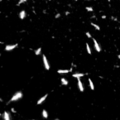
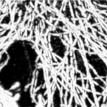
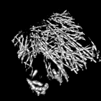
Appendix 6: Tracking in the X-Y-T coordinate
3D Kymograms in cell biology
Bacterial shape, actin dynamics …
Classic analysis: 3D segmentation (UCSF Chimera, ImageJ)
Signatures (of a small object)
Stationary object → Straight line (along the T axis)
Rotating object → Helix
Moving object along a line with constant speed → Straight line (not parallel with the T axis)
Moving object along a line with nonuniform speed → Curve
Exercise 37: Generating time-lapse patterns and plotting tracks (with Macro)
Time-lapse pattern of mammalian cells (left); their corresponding tracks in 2D (middle); and the distinguishable tracks in the 3D XYT space (right). The image at the left has been obtained by performing Maximum Intensity Projection (over 8 z slices of a 4D stack); followed by a 3-class Weka segmentation (background, autofluorescence, signal). Another Maximum Intensity Projection along time has generated the image in the middle. Sample preparation and imaging has been done by Holger Lorenz using a Zeiss LSM780 confocal microscope.

Slide 52
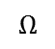
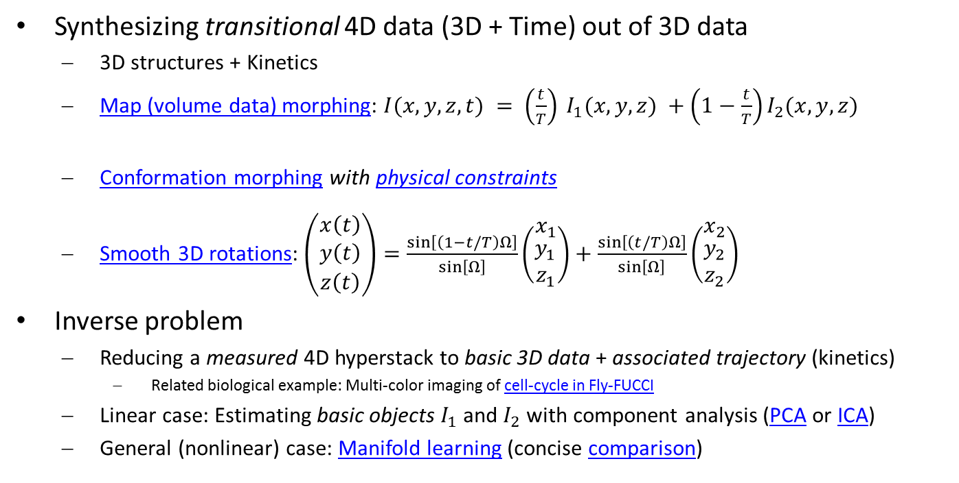
Appendix 7: Morphing and Component Analysis
Synthesizing transitional 4D data (3D + Time) out of 3D data
3D structures + Kinetics
Map (volume data) morphing: $I(x,y,z,t) = \left(\frac{t}{T}\right) I_{1}(x,y,z) +\left(1−\frac{t}{T}\right)I_{2}(x,y,z)$
Conformation morphing with physical constraints
Smooth 3D rotations: $\left(\begin{matrix}x\left(t\right) \\ \begin{aligned}y\left(t\right) \\ z\left(t\right)\end{aligned}\end{matrix}\right)=\frac{\sin\left[\left(1−t/T\right)Ω\right]}{\sin\left[Ω\right]}\left(\begin{matrix}x_{1} \\ \begin{aligned}y_{1} \\ z_{1}\end{aligned}\end{matrix}\right)+\frac{\sin\left[\left(t/T\right)Ω\right]}{\sin\left[Ω\right]}\left(\begin{matrix}x_{2} \\ \begin{aligned}y_{2} \\ z_{2}\end{aligned}\end{matrix}\right)$
Inverse problem
Reducing a measured 4D hyperstack to basic 3D data + associated trajectory (kinetics)
Related biological example: Multi-color imaging of cell-cycle in Fly-FUCCI
Linear case: Estimating basic objects $I_{1}$and $I_{2}$ with component analysis (PCA or ICA)
General (nonlinear) case: Manifold learning (concise comparison)
4D Data
Kinetics
3D Data
Kinetics
3D Data
$$Ω$$

Slide 53
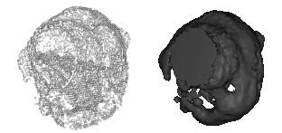
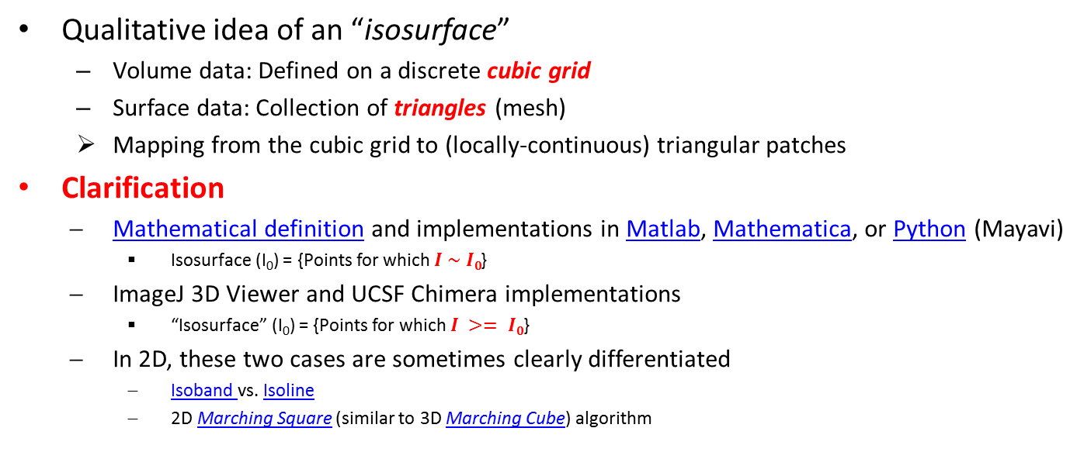
Appendix 8: “Isosurface” and two meanings
Qualitative idea of an “isosurface”
Volume data: Defined on a discrete cubic grid
Surface data: Collection of triangles (mesh)
Mapping from the cubic grid to (locally-continuous) triangular patches
Clarification
Mathematical definition and implementations in Matlab, Mathematica, or Python (Mayavi)
Isosurface (I₀) = {Points for which $I \sim I0$}
ImageJ 3D Viewer and UCSF Chimera implementations
“Isosurface” (I₀) = {Points for which $I >= I0$}
In 2D, these two cases are sometimes clearly differentiated
Isoband vs. Isoline
2D Marching Square (similar to 3D Marching Cube) algorithm
Visualization of Yeast cells with two definitions of “iso-surfaces”: 3D contour (left) and thresholding as done by ImageJ 3D Viewer and UCSF Chimera (right). Sample preparation and imaging by Christian Hörth using a Leica TCS SP5 confocal microscope.

Slide 54
Appendix 9: 3D ROIs
Direct physical 3D input (Chimera)
Rendered 3D Input
Volume erasing/sectioning/segmenting + surface clipping/capping (Chimera)
Selection Tools (ImageJ)

Slide 55
Appendix 10: Configuring your next computer
Optimizing memory (RAM), processor power, graphics card …
Exercise 39: Configure a workstation with a given budget
For handling very large datasets (memory …)
For fast computation (processor …)
For fast visualization (graphics card …)
For all three
Note: Links to commercial products are for mere educational purposes. No manufacturer, vendor, or product is endorsed or in any other way promoted.

